Slide 1
Page Replacement Algorithms Alok Jhaldiyal Assistant Professor SoCS, UPES

Slide 2
Page Replacement- Need
To support degree of multiprogramming in a system.
Supports the paradigm that main memory can at a single instant hold limited pages.
Comes into play when page fault occurs.
Page fault can be termed as an operating system trap.
If the page to be removed has been modified while in memory, it must be rewritten to the disk to bring the disk copy up to date

Slide 3
Basic Page Replacement
If no frame is free, we find one that is not currently being used and free it.
Frame can be made free by writing its contents to swap space and changing the page table.
The freed frame can now be used to hold the page for which the process faulted.

Slide 4
Page Replacement Strategy
1. Find the location of the desired page on the disk.
2. Find a free frame:
a. If there is a free frame, use it.
b. If there is no free frame, use a page-replacement algorithm to select a victim frame.
c. Write the victim frame to the disk; change the page and frame tables accordingly.
3. Read the desired page into the newly freed frame; change the page and frame tables.
4. Continue the user process from where the page fault occurred.

Slide 5
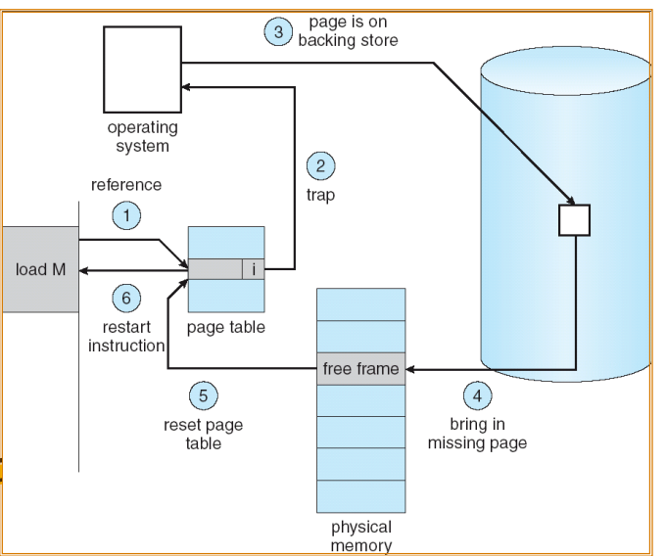
Handling Page Fault

Slide 6
Page Replacement Algorithms
Operating System uses various algorithms to implement page replacement, listed below:
Optimal page replacement algorithm
Not recently used page replacement
First-In, First-Out page replacement
Least recently used page replacement

Slide 7
Optimal Page Replacement Algorithm
The algorithm has lowest page fault rate of all algorithms.
Algorithm Statement: Replace the page which will not be used for longest period of time.
Future knowledge of reference string is required.
Never suffer from Belady’s anomaly
Belady’s anomaly: for some page-replacement algorithms, the page-fault rate may increase as the number of allocated frames increases

Slide 8
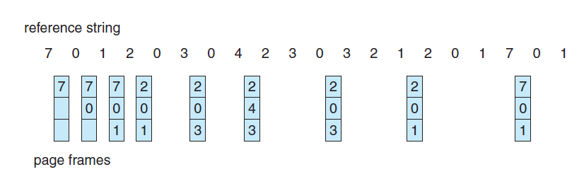
Optimal Page Replacement Algorithm

Slide 9
FIFO Page Replacement
Simplest page-replacement algorithm.
FIFO replacement algorithm associates with each page the time when that page was brought into memory.
When a page must be replaced, the oldest page is chosen

Slide 10
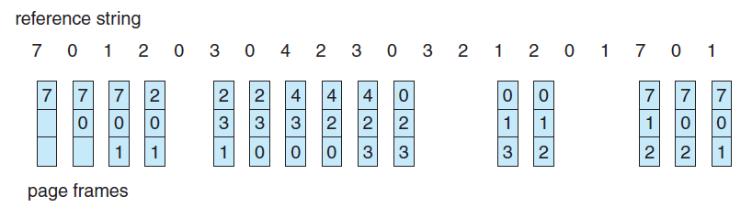
FIFO Page Replacement Algorithm

Slide 11
LRU Page Replacement
FIFO algorithm uses the time when a page was brought into memory.
OPTIMAL algorithm uses the time when a page is to be used.
LRU Algorithm use the recent past as an approximation of the near future.
Replace the page that has not been used for the longest period of time.
LRU replacement does not suffer from Belady’s anomaly

Slide 12
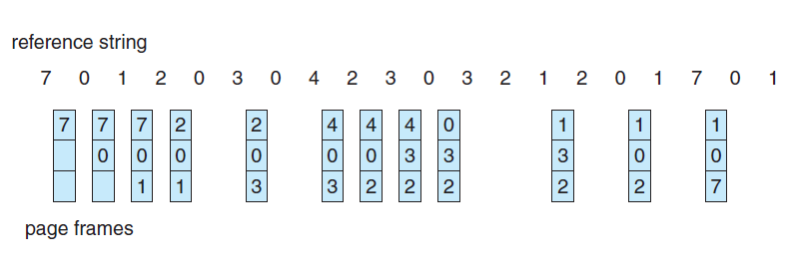
LRU Page Replacement Algorithm

Slide 13
Self Study
Demand Paging
Allocation Algorithms:
Equal Allocation
Proportional Algorithms
Thrashing

Slide 14
Problem
Reference String: 0,2,1,6,4,0,1,0,3,1,2,1
For the above mentioned string implement the following algorithms and compute no. of page faults that have occurred and also compute fault rate.
LRU
Optimal
FIFO
Consider no of available locations to be 3.

Slide 15
Belady’s Anomaly Test
Reference String: 1, 2, 3, 4, 1, 2, 5, 1, 2, 3, 4, 5
Using the above given ref. string, justify that only FIFO page replacement algorithm suffers from Belady’s Anomaly.

